Slide 1
Employee Data Analysis using Excel
STUDENT NAME: SARANYA. K.S
REGISTER NO:312209349
DEPARTMENT: B.COM (GENERAL)
COLLEGE: ANNA ADARSH COLLEGE FOR WOMEN

Slide 2
PROJECT TITLE
Employee Performance Analysis using Excel

Slide 3


AGENDA
Problem Statement
Project Overview
End Users
Our Solution and Proposition
Dataset Description
Modelling Approach
Results and Discussion
Conclusion
3/21/2024 Annual Review

Slide 4

PROBLEM STATEMENT THE EMPLOYEE PERFORMANCE IS USED FOR THE PURPOSE FOR EMPLOYEES BENEFITS. THE PURPOSE LIKE BONUS, INCREMENTS, WAGES CALCULATIOINS, ETC.,

Slide 5

PROJECT OVERVIEW EMPLOYEE DATA ANALYSIS IS ALL ABOUT OVERVIEWING ABOUT EMPLOYEE’S PERFORMACE BY THEIR PERFORMACE LEVEL, RATINGS, GENDER ETC.,
.

Slide 6




WHO ARE THE END USERS? 1)EMPLOYEE 2) EMPLOYERS 3)ORGANISATIONS

Slide 7

OUR SOLUTION AND ITS VALUE PROPOSITION 1)Conditional formatting: highlight for missing values 2)Filter: Remove 3)Formula: Performance 4)Pivot table: Summary 5)Graph: Data visualization

Slide 8
Dataset Description
EMPLOYEE DETAILS: KAGGLE
EMPLOYEE ID : NUMERIC
EMPLOYEE NAME : FIRST NAME TEXT
LAST NAME
EMPLOYEE TYPE
PERFORMANCE LEVEL
EMPLOYEE RATINGS
BUSINESS UNITS
GENDER

Slide 9

THE "WOW" IN OUR SOLUTION
PERFORMANCE LEVEL:-
=IF(I6>=4,"High",IF(I6>=3,"Med","Low"))
3/21/2024 Annual Review
9

Slide 10
MODELLING
MODELLING
1)DATA COLLECTION:
EMPLOYEE DETAILS ARE COLLECTED FROM KAGGLE
2) FEATURE COLLECTION
CONDITIONAL FORMATTING TO HIGHLIGHT THE EXIT EMPLOYEES
3) DATA CLEANING
4) PERFORAMCE LEVEL:
THIS CATEGORY IS CALCULATED BASED ON THE RATINGS COLUMN BY USING THE FORMULA
=IF(I6>=4,"High",IF(I6>=3,"Med","Low"))
10

Slide 11
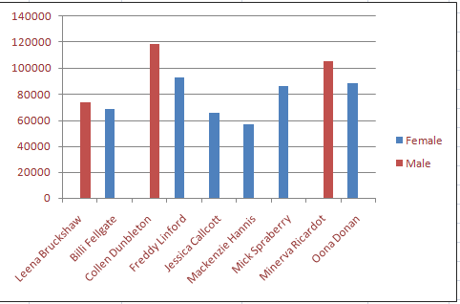
RESULTS
11

Slide 12
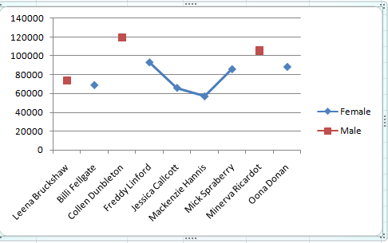

Slide 13
Conclusion
FROM THIS, I CONCLUDE MY TOPIC THAT IN EXCEL I HAD THE EMPLOYEES DETAILS FROM KAGGLE.
I HAD 9 FEATURES IN THE DETAILS
I USED CONDITIONAL FORMATING TO HIGHTLIGHT THE EXIT EMPLOYEES
FROM THE TABLE, I DONE PIVOT TABLE AND THROUGH THAT I INSERT GRAPHS.
FOR CALCULATING THE EMPLOYEES PERFORMANCE LEVEL I USED ONE FORMULA BASED ON THE EMOLYEE RATINGS.
FOR THIS EMPLOYEE DATA ANALYSIS, I USED FILTERS, FONT RIBBON,
TEXT ALLIGNMEN T ETC.,

